Slide 1

Preattentive attributes and visual design
Sean Oslin
DRAFT 2 10/16/19

Slide 2
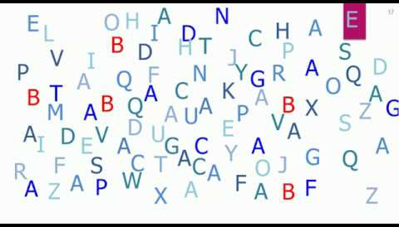
What are preattentive attributes?
Pre - before
Attentive - what you notice on a conscious level
Attributes - characteristics
Notes:
Definition: Visual property which is processed in spatial memory without our conscious action.
Think: immediate, instinctive, automatic
Or, what your eye is drawn to
And, FAST!

Slide 3
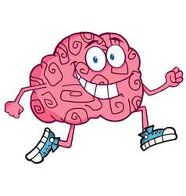
How fast your brain processes PAA?
5 seconds?
1 second?
.5 seconds?
.05 seconds?
Notes:
Our brain does some things faster than others. How long do you think it takes for your brain to respond to preattentive attributes?
Half a second. Time enough to react without thinking.
Split-second decisions are real.

Slide 4
4 PAA properties
Color
Form
Mo--v---em----en-------t
Spatial Positioning
Notes:
What are the 4 properities of preattentive attributes

Slide 5
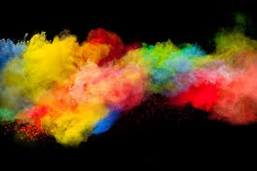
Color
Notes:
Color is comprised of 3 elements.

Slide 6
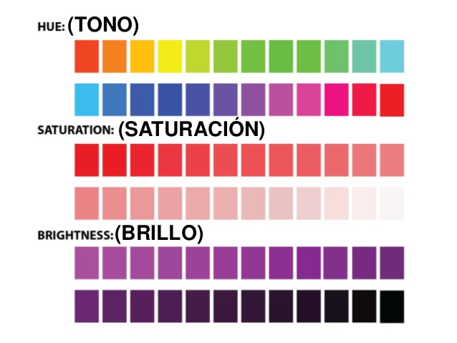
Color properties
Notes:
Let’s explore what we mean by these 3 concepts.
Hue is a measure of the color that we give a name to such as “Red” or “Violet”.
Saturation and lightness/brightness are a measure of color intensity.
Hues and intensities help us separate visual elements from their surroundings.
This saves the user from having to perform a visual search through data.
Here are some examples

Slide 7
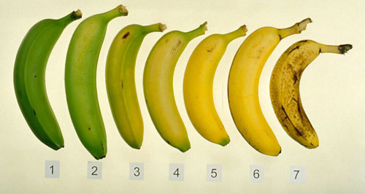
Hue: how ripe are my bananas?
Notes:
Hue is the easiest color concept to understand.
Example of how hue changes during the ripening process.
What number represents your ideal eating banana? Making banana bread?

Slide 8
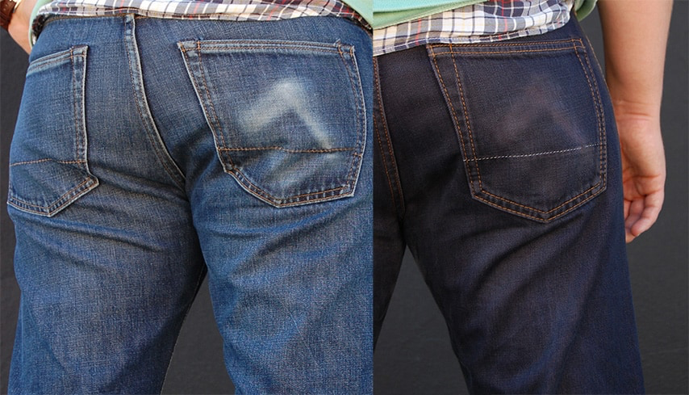
Saturation: same hue, different intensity
Notes:
Color saturation is the intensity of a hue. It is the amount of grey in a color.
Maximum saturation is pure color. Minimum is washed out, faded, pastel, etc.
Why does saturation matter? Our eyes are drawn to pure, intense colors. Also, using a continuum of saturations for a single color allows us to add variety to a presentation without overwhelming our eyes with too many colors.

Slide 9
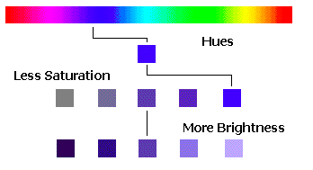
Brightness: it’s black & white
Notes:
Brightness is the relative lightness or darkness of a particular color, from black (no brightness) to white (full brightness).
Brightness is also called Lightness in some contexts. In Tableau, saturation is called Opacity and is measure as a percent.
The difference between saturation and brightness is very important in photography and image processing applications. It is less important in creating visualizations using charts and graphs.
The takeaway: if you want turn a blue sky grey, lessen the saturation. If you want to make a dark blue sky a lighter shade of blue, increase the brightness.

Slide 10
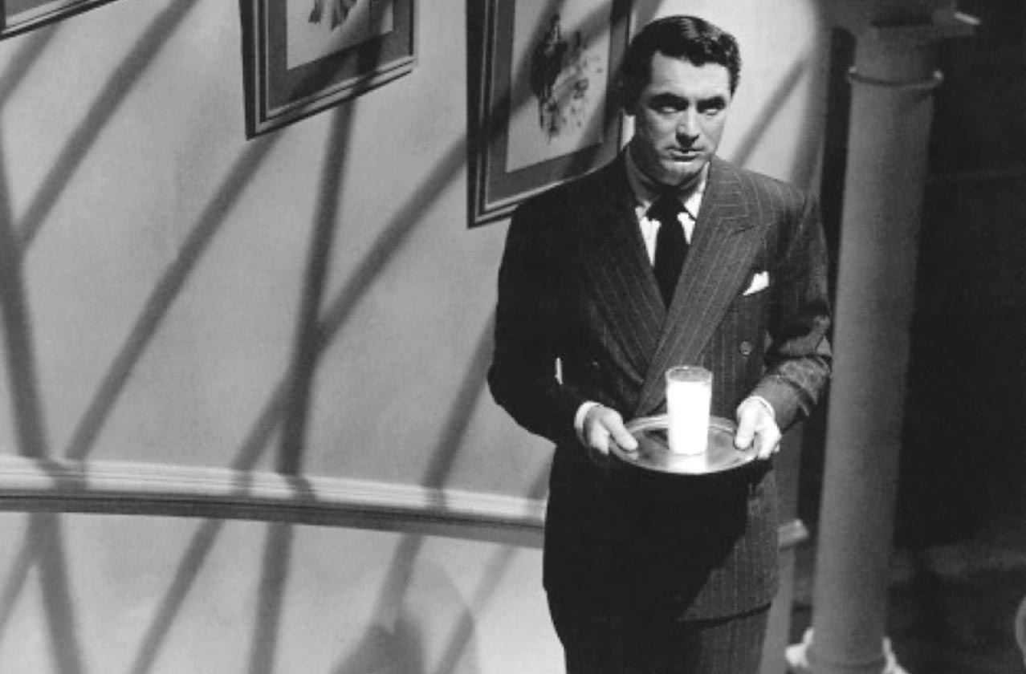
Notes:
Example of brightness: where does your eye go in this movie still.
Cary Grant in Alfred Hitchcock’s Suspicion (1941)

Slide 11
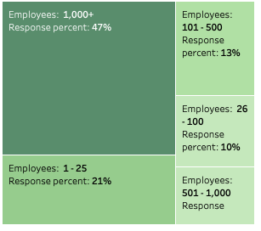
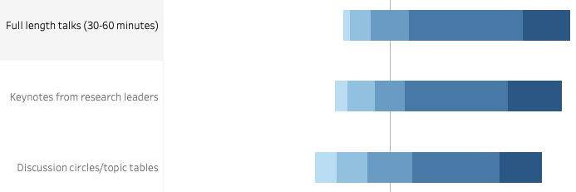
Using brightness to convey information
Notes:
In these examples, brightness is coupled with geometric area to convey information about the relative strength/size/importance of each data element. Visualization software has color-blind palettes. I use these frequently.

Slide 12
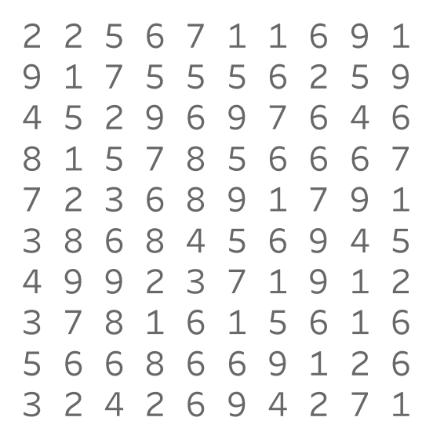
How many 9s?
Notes:
Color helps as pick details out of a crowd.

Slide 13
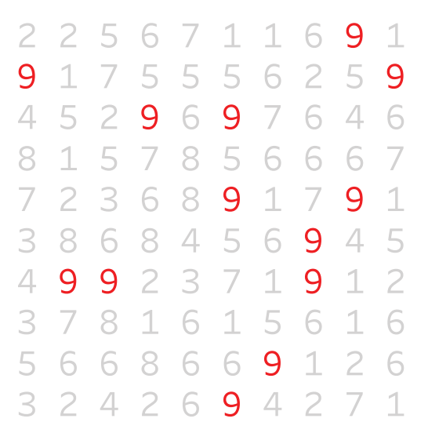
Easier?
Notes:
Our eyes are drawn to the color.
You see this technique used in crowd scenes in movies and TV shows.

Slide 14
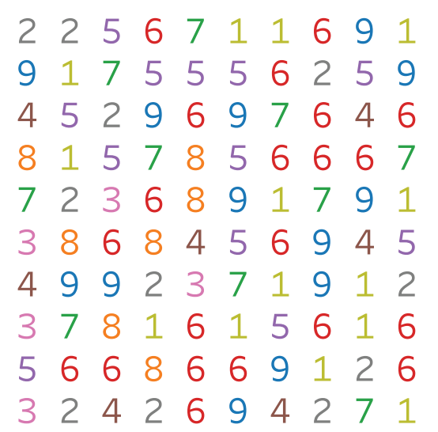
How about now?
Notes:
Too much color is as bad as none at all.
Remember: colors are accents. Also, black is an accent color in visualizations.

Slide 15
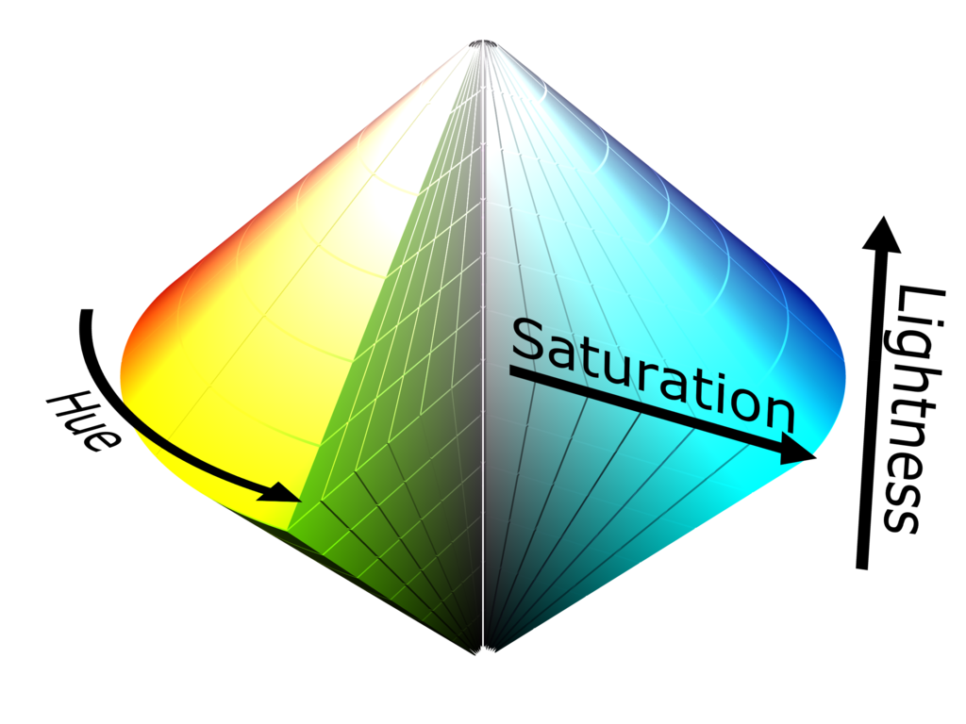
Hue, saturation, brightness (lightness)
Notes:
Here is another visual explaining the difference between hue, saturation and brightness.

Slide 16
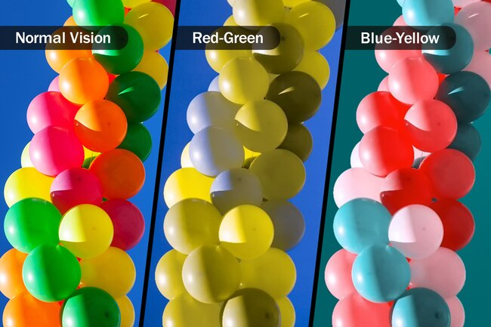
Color blindness
Notes:
Color blindness affects approximately 1 in 12 men (8%) and 1 in 200 women in the world. There are 3 types (only 2 are shown), with red-green being the most common. Be aware of this when combining colors.

Slide 17
Takeaways
Colors are for emphasis,/accent - use sparingly!
Contrast gives a sense of balance (red/blue, orange/purple)
Black is an accent color
Color code your visuals to the type of graph (e.g. bar charts are blue, line charts are red, treemaps are green)
Be aware of colorblindness.
Be conservative, use (develop!) some taste

Slide 18
Color and working with clients
When you create a draft of a data viz, only use grayscale colors.
Your customers often become preoccupied with color choice and ignore what is being communicated.
Take color out of the mix to help focus their attention on the content. Add color once all decisions are made

Slide 19
Form
Form can be manipulated to either call attention to a member of the data set or to reduce our attention on it.

Slide 20
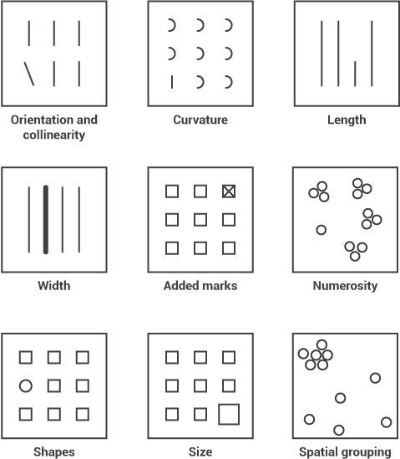
What seems to be missing?

Slide 21
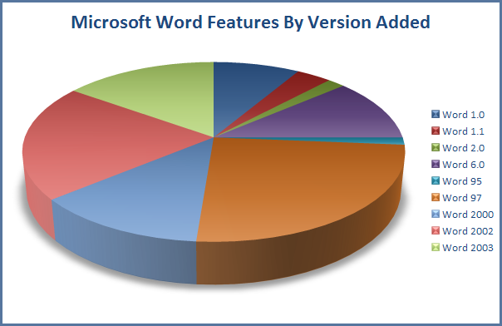
No, NO, NO!!!!
Proportions
and 3D
(also, too much color and no labels)
What would be a better chart type?

Slide 22
